Slide 1

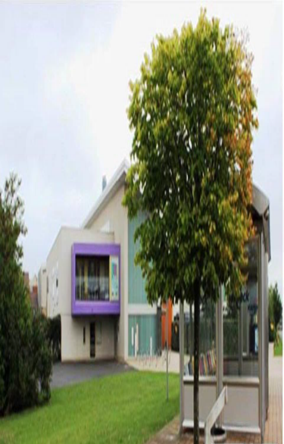





Need to Chat about School, Home
or someone to chat with about your time in lockdown?
You can Text or Call a Youth worker
It’s Totally confidential
Contact us on
Jane - O7970 887950/07860 786055
Bethel – 07970 887471/07740 184063
Neil – 07917 639099
Between 11am – 8pm
We are here to support you
Dartford Youth Hub – Bridge 4 young people
@bridge4yp
The Bridge 4 Young People
Dartford Youth Hub
Learning & Community Campus
Birdwood Avenue
Dartford Kent DA1 5GB
Tel:- 03000 420691
Email:- dartfordyouth@kent.gov.uk
@bridge4yp

